Slide 1
Fractional Oxidational States
Group work done by:
Yash
Ayush
Atharv

Slide 2
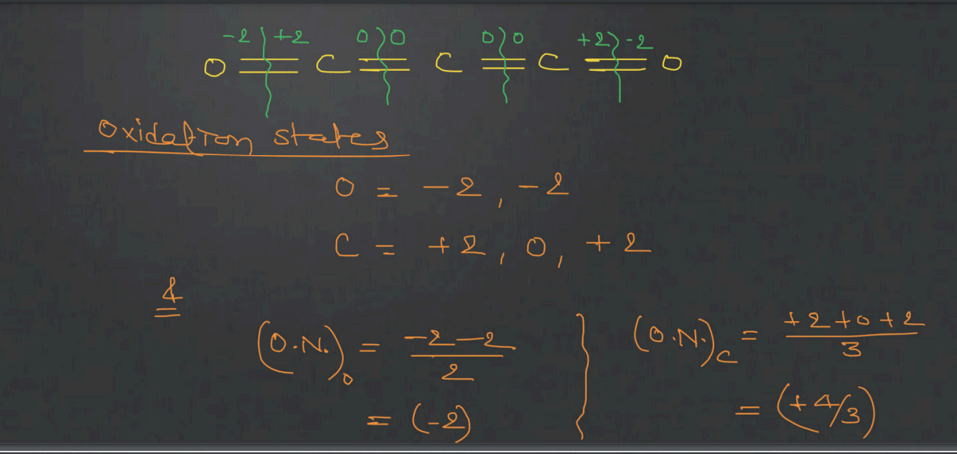
C₃O₂

Slide 3
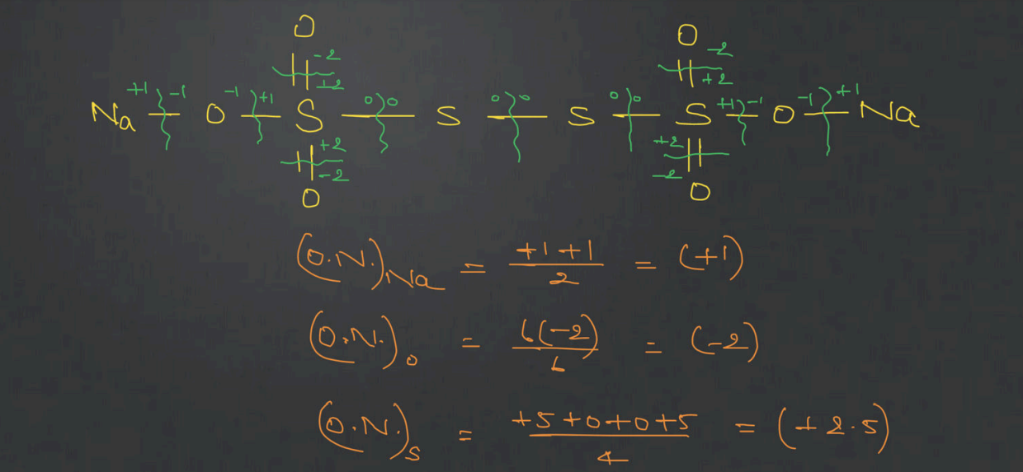
Na₂S₄O₆

Slide 4
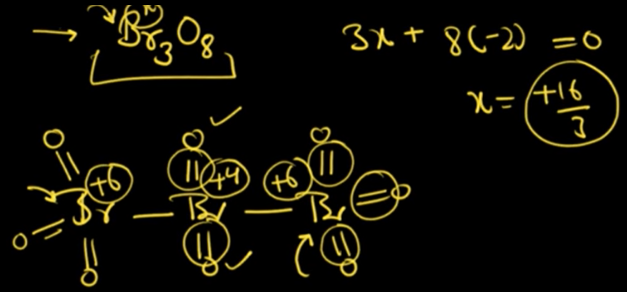
Br₃O₈

Slide 5
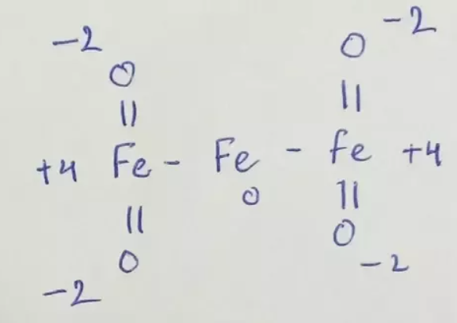
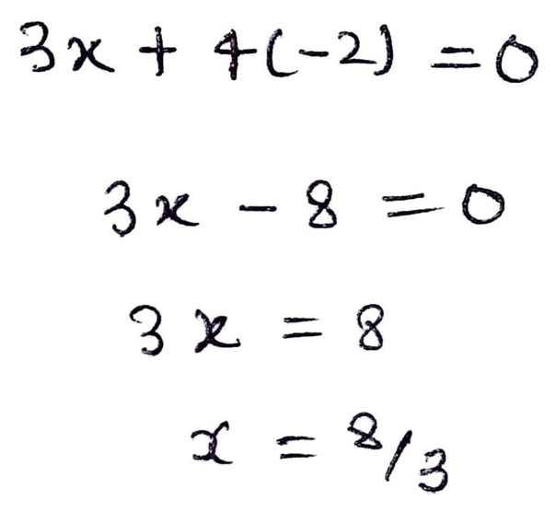
Fe₃O₄

Slide 6
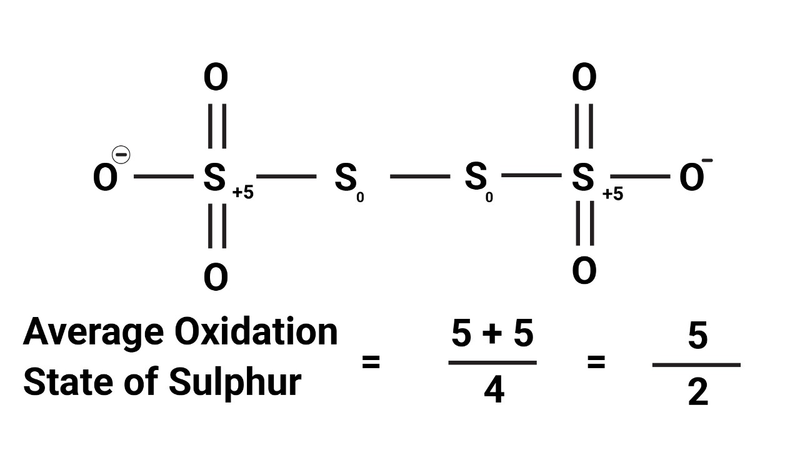
S₂O₆²⁻

Slide 7
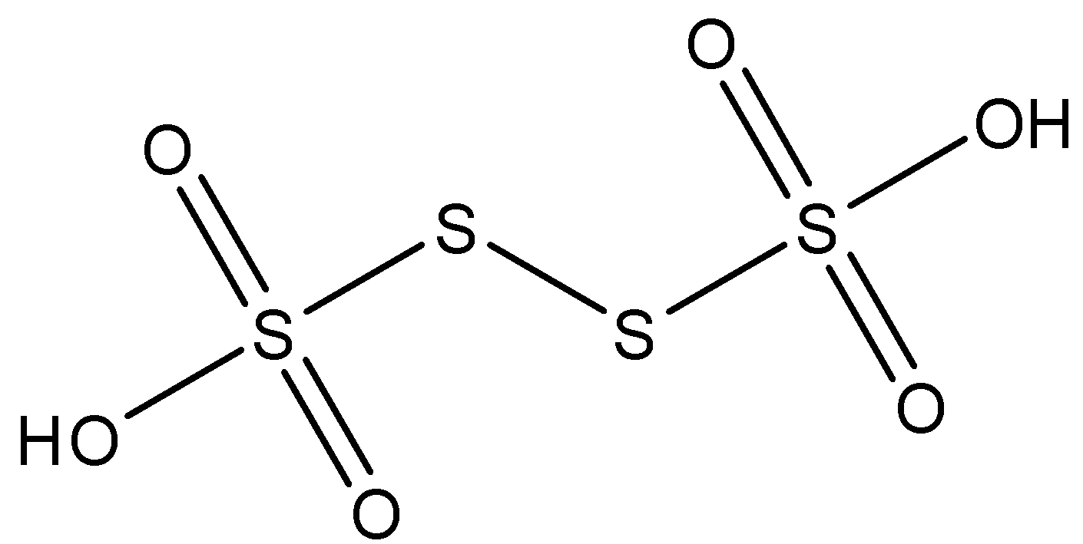
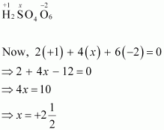
H₂S₄O₆

Slide 8


